Slide 1
980RT-8730CN-18K-A10 Layout Notes
2026/10/12

Slide 2
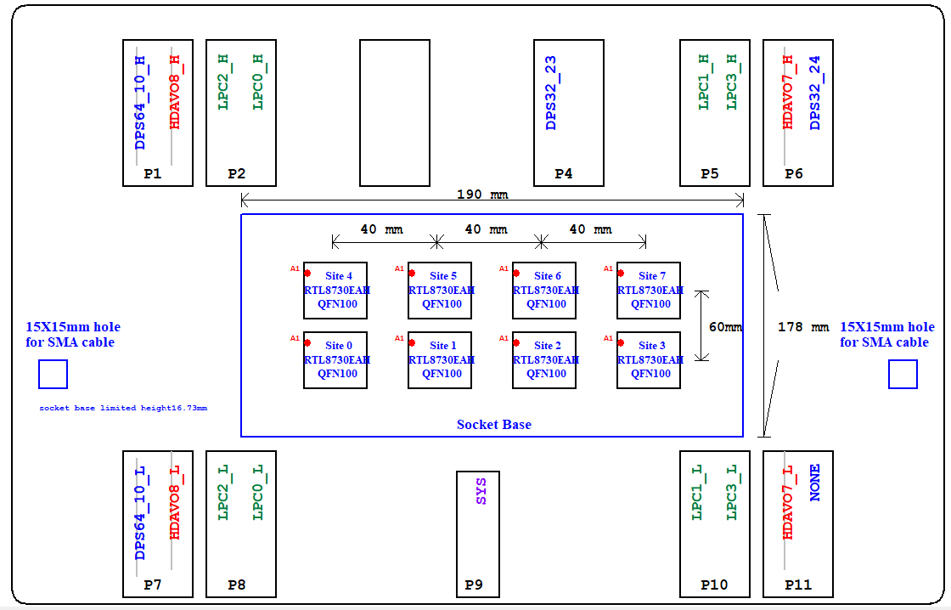
NOTES 1
Please refer to the page A0000_Config_C3680RF in DSN for the tester configuration.

Slide 3
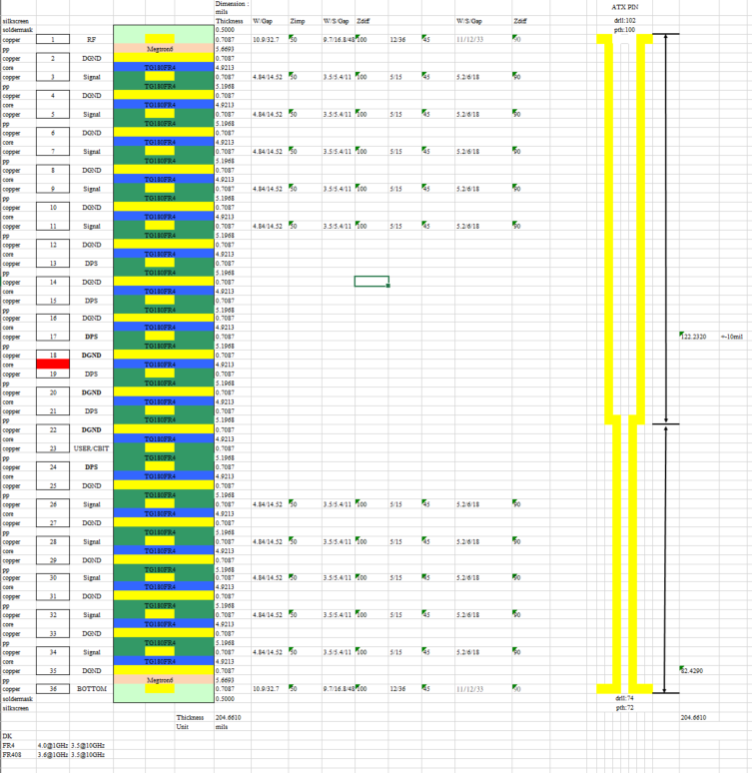
NOTES 2
Please refer to 980RT-8730CN-18K-A10_Stackup_36L_20261012.xls for the PCB stackup, trace width, and spacing of impedance-controlled lines on each layer.

Slide 4
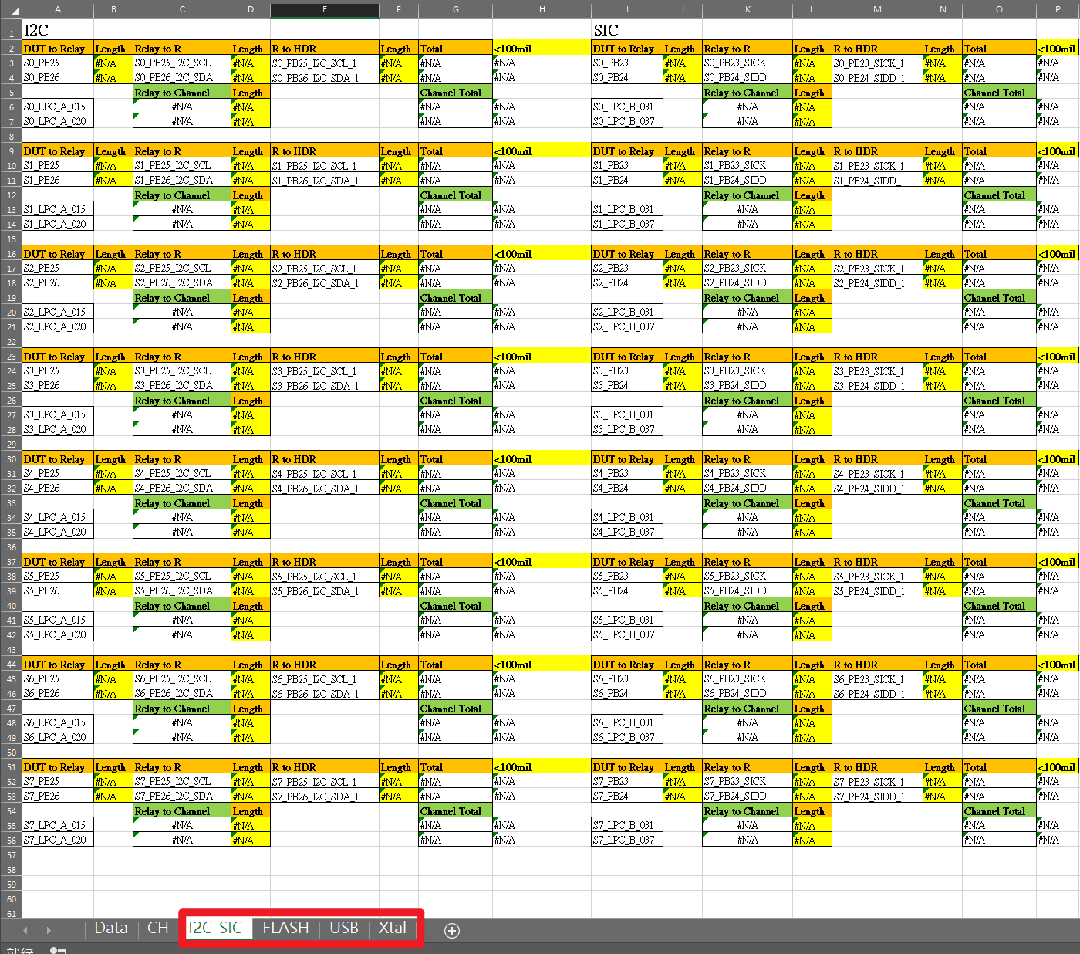
NOTES 3
Please refer to 980RT-8730CN-18K-A10-E-Length-1008.xlsx for the trace length matching/control calculation.

Slide 5
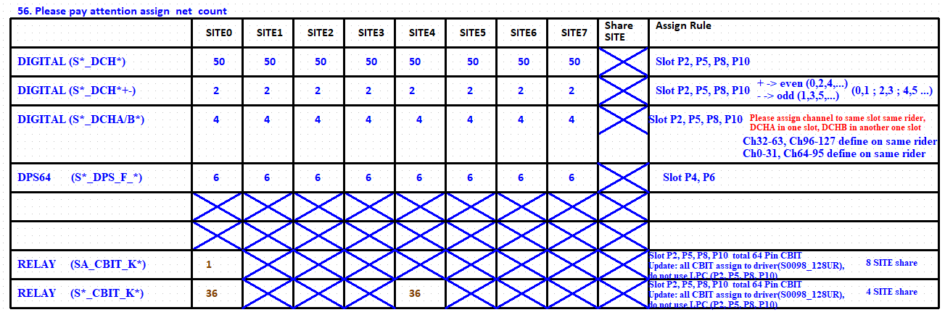
NOTES 4
Please refer to the DSN page X001_Assign_Rule for the names, quantities, and assignment rules of channels, power, and relays.

Slide 6
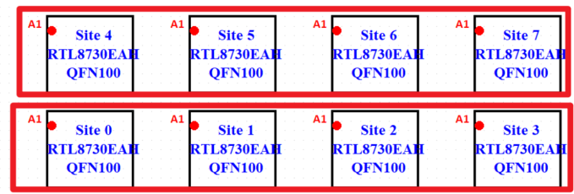
NOTES 5
Group SITE0–SITE3 as one group and SITE4–SITE7 as another. Within each group, the routing and power fan-out for each layer must be identical across all sites. However, the fan-out can differ between the two groups. For example, the fan-out must be identical among SITE0–SITE3 and identical among SITE4–SITE7, but the fan-out for SITE0–SITE3 can be different from that of SITE4–SITE7.

Slide 7
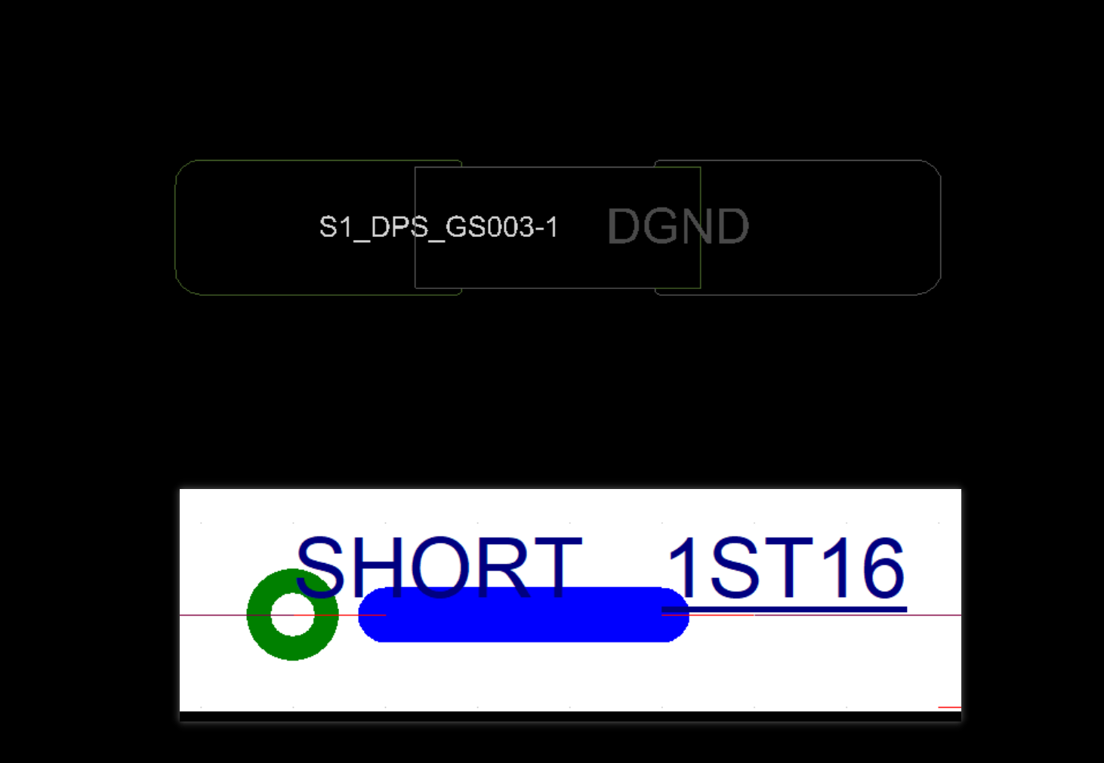
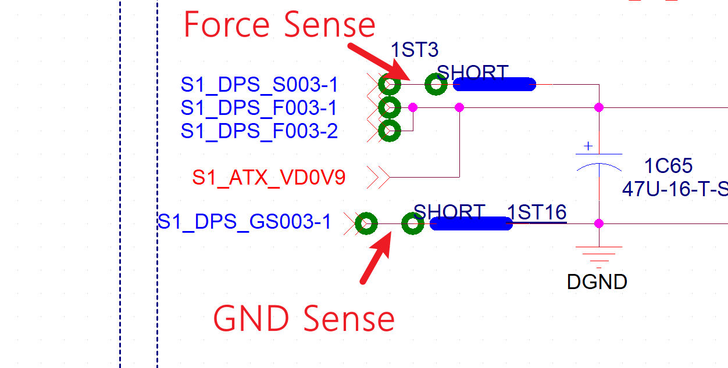
NOTES 6 / 7 / 8 / 9
All shorter components should be placed in proximity to the DUT/Relays according to the power flow.
All pins of shorted components can be placed on their respective power planes and connected to the first fan-out via of the DUT power, using an 8-mil trace on inner layers or a 10-mil trace on outer layers.
For each FORCE group, the Force Sense and GND Sense traces must be routed on the same layer and placed adjacent to the FORCE plane.
Power merges must follow a sequential numbering sequence. Merging across slots is strictly prohibited. For instance, merging S23_dps_f00 with S23_dps_f01 is compliant, while merging S23_dps_f31 with S24_dps_f00 is non-compliant

Slide 8
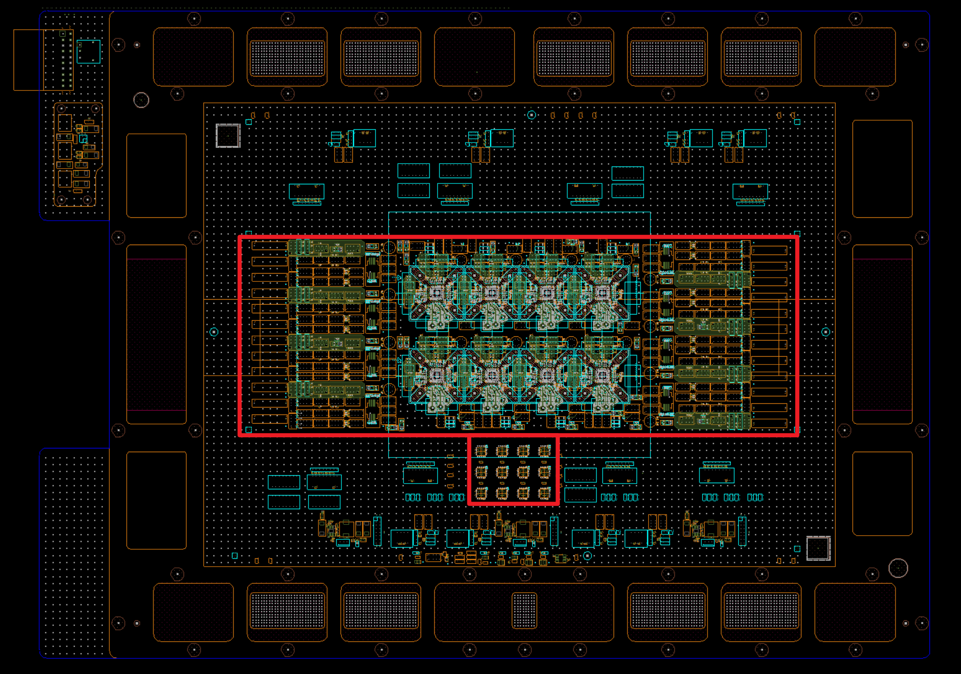
NOTES 10
The routing, power planes, and vias on the TOP/BOTTOM layers near the DUT have been pre-allocated. You may consider reusing this design directly。The routing, power planes, and vias on the TOP/BOTTOM layers near the DUT have been pre-allocated. You may consider reusing this design directly. For the inner layer power planes and routing fanout, please refer to 038RT-L8730A16Q-A100_Final_CC.brd.

Slide 9
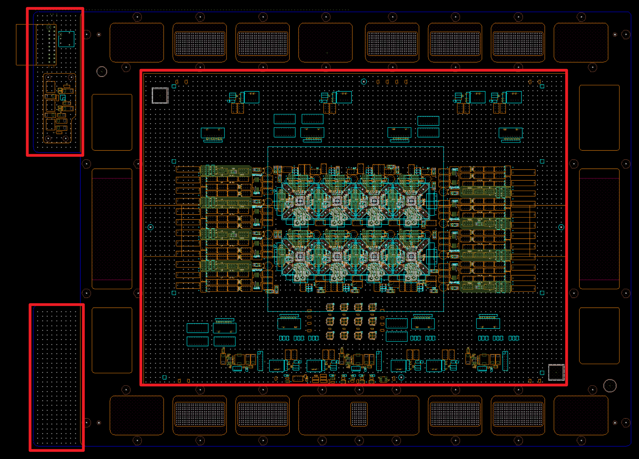
NOTES 11
GND vias have been pre-placed in large open areas and can be utilized directly

Slide 10
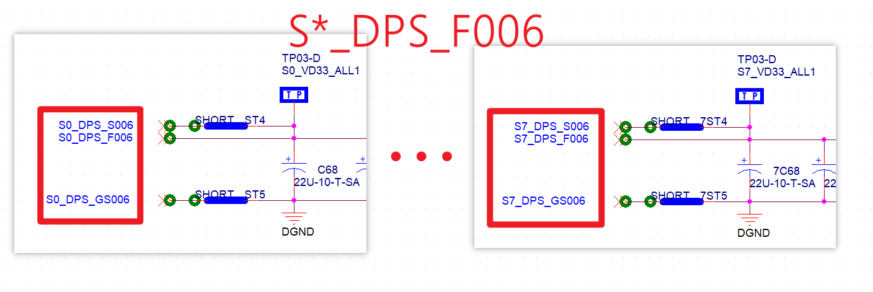
NOTES 12 / 13 / 14 /15
Calculate the width for a 1A power plane or trace at 60 mils, and increase the width as much as possible where space allows.
Please calculate the required number of vias based on a 12 mil drill size supporting 1A of current. For a 1A current requirement, please use two 12 mil vias.
For CBIT signals, please use a trace width of 8 mil on internal layers and 10 mil on surface layers. Additionally, CBIT signals should be concentrated on layer L23_User_Cbit as much as possible.
The same signal /power for each site must be routed on the same layer. For example, if the S0_DPS_F006 power for SIT0 is routed on L13, then the S*_DPS_F006 for all other sites must also be on L13.

Slide 11
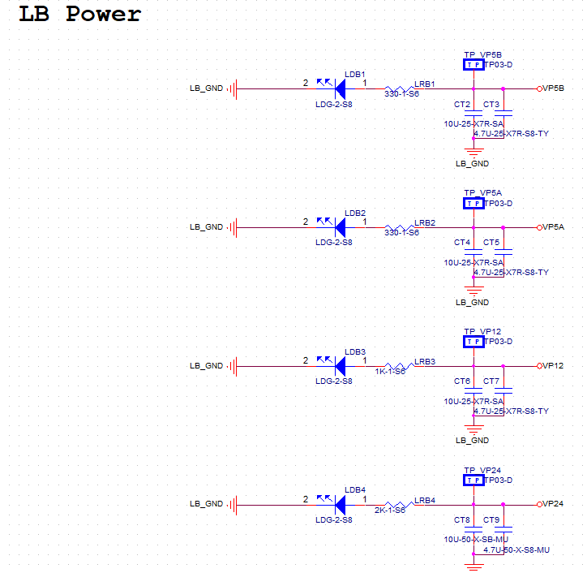
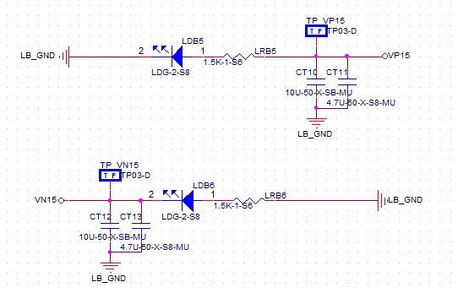
NOTES 16
Please route User Power on layers L23_User_Cbit as much as possible. Examples include: VP5B / VP5A / VP12 … etc. Please refer to the DSN page S0099_MISC

Slide 12
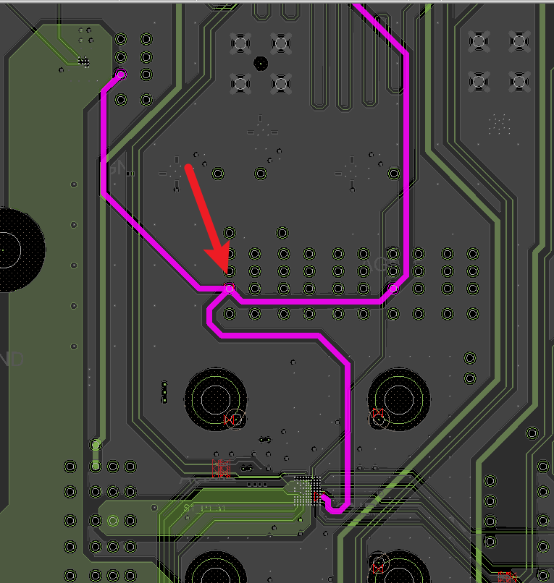
NOTES 17 / 18 / 19
Please route User Power on layers L23_User_Cbit as much as possible. Examples include: VP5B / VP5A / VP12 … etc. Please refer to the DSN page S0099_MISC
Apply the 3W rule to all impedance-controlled traces, with the exception of component fan-out regions
For all impedance-controlled traces / CBIT traces and power trace, three-way T-junctions at a single point (pin or via or cline) are strictly prohibited, even if the three cline segments are routed on different layers.

Slide 13
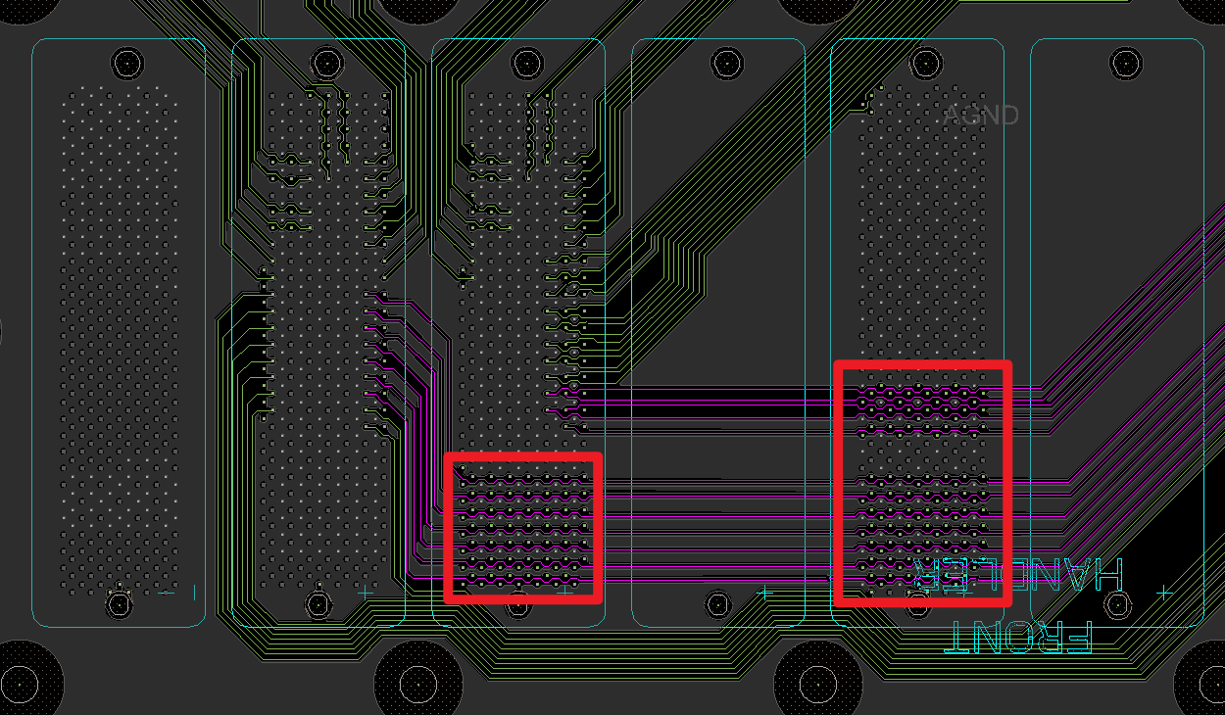
NOTES 20 / 21
Where space allows, routing is strictly prohibited under or through components with symbol names prefixed with 'PG_'.
The routing sequence must be perfectly identical across all sites. For example, if the routing order for a net is SITE0 -> R1 -> C1 -> R2, then the sequence for SITE7 must be SITE7 -> 7R1 -> 7C1 -> 7R2, and so on.

Slide 14
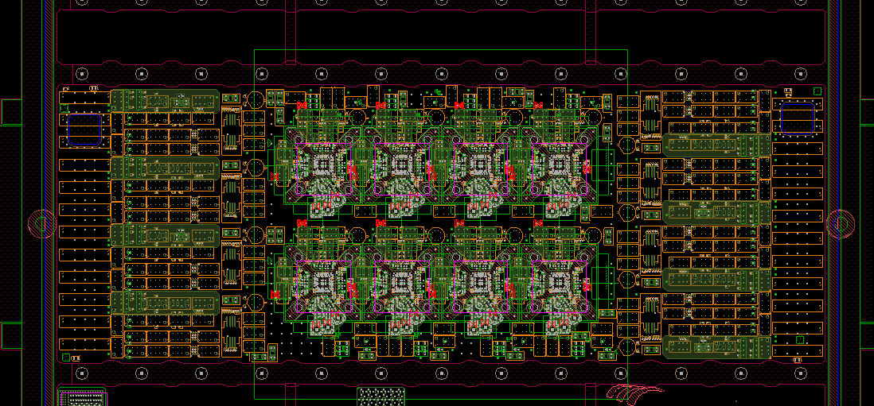
NOTES 22
The Channel / Power and Cbit routing can be referenced from 038RT-L8730A16Q-A100_Final_CC.brd.

